Slide 1
Please make sure you have paper and a pen or pencil. Mrs Evans and Mr Ryder

Slide 2
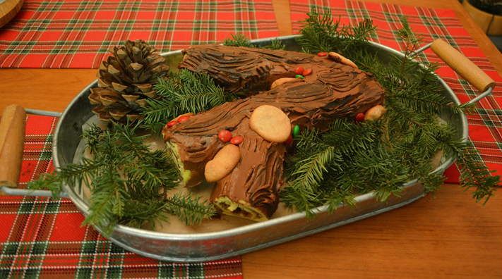
Thursday 17th December
PHSE
Mrs Evans ad Mr Ryder
Christmas, Paganisms and Britain
LO: To develop an understanding of the origins of the Festive Season.

Slide 3
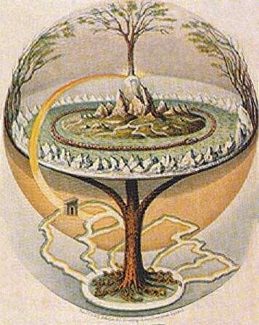
Christmas, Paganism and Britain.
The origins of the Festive Season
Challenge: What do these two images show?
More challenging: How are these two images linked to Christmas?
Mega challenge: Explain what we mean by the term ‘Pagan’ and how these images might link with Paganism.

Slide 4
KEY WORDS:
Paganism – a religion other than one of the main world
religions, specifically a non-Christian or pre-Christian religion.
Yule (or Jol) – Pagan festivity, later taken over by Christianity as part of Christmas.
Success Criteria
Challenge: Identify how Pagan traditions have helped form the Christian festival of Christmas.
More challenging: Describe in detail at least three traditions that have been adapted from Paganism into the Christian Christmas.
Mega challenge: Evaluate whether Christmas is a Pagan festival in all but name and explain issues Christians have encountered through history due to celebrating Christmas.

Slide 5
Unbelievably, this image of the left is an impression of one of the first ‘Christmas Trees’ although the idea was used in a very different way today. Pagans used to be worshippers of trees, believing they were the key to life.
Pagans also believed that evergreens would scare away the Devil – so were perfect to bring home for dark winter nights.

Slide 6
Some of us might have the tradition of having a ‘chocolate log’ at Christmas. This comes from the pagan Winter Solstice festivals in Scandinavia and other parts of northern Europe, such as Germany. The Yule Log was originally an entire tree, that was carefully chosen and brought into the house ready for celebrations.
Part of the log would be burned to keep the home bright and warm. It would be lit with the leftover remains of last year’s log.

Slide 7
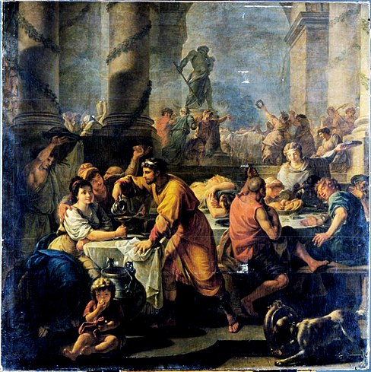
Task: So is Christmas really a Pagan festival?
Watch the two clips.
Then answer the questions on the next slide.
https://www.youtube.com/watch?v=Ots9y_xcaX8 (up to 14.35)
https://www.youtube.com/watch?v=LliqvacoNu8 (all)

Slide 8
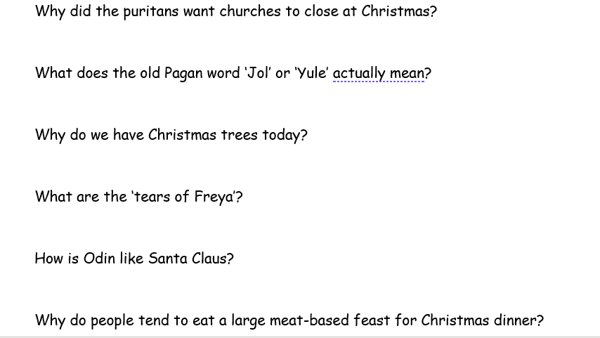
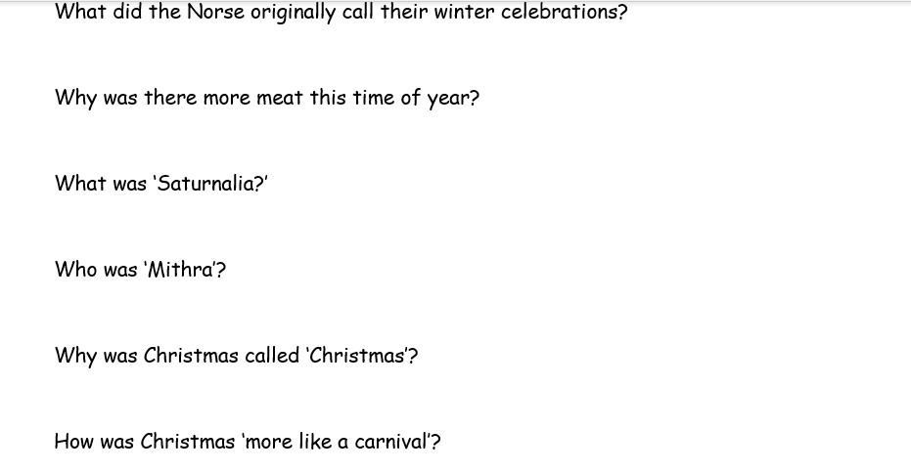
Task: So is Christmas really a Pagan festival?
Activity…

Slide 9
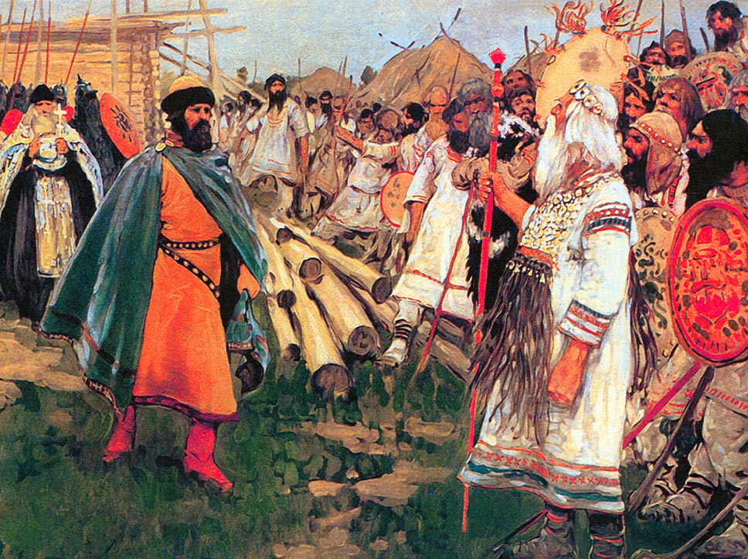
Task 2: The merger of Christian and Pagan ideas
You are going to now create an advert.
You are a Dark-Age Pagans who wants
to persuade Christians that your
winter festivities and theirs can fit
nicely together (so there’s no need
for their Roman masters to come
over and start more fights!)
Challenge: You must describe how three
Pagan traditions complement Christian ideas.
More challenging: You must explain three of your traditions in detail as well as how Christians can adapt them and evolve them.
Mega challenging: Explain to the possible culture-clash issues they may encounter in future – why - and how they can overcome these in a positive way (e.g. Puritanism, underground Christmas and the Restoration).

Slide 10
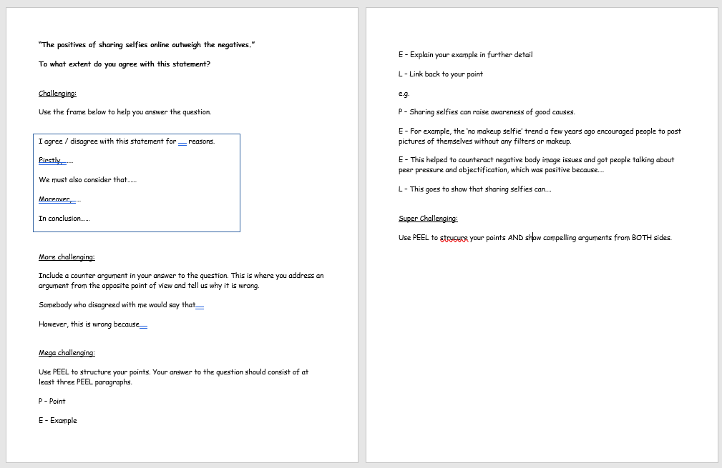
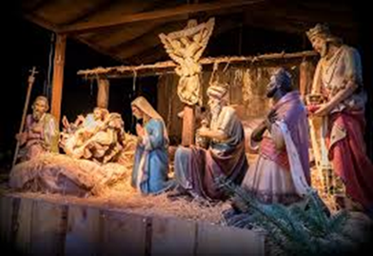
Plenary:
“Christmas is a Pagan festival in all but name.”
To what extent do you agree with this statement?

