Slide 1
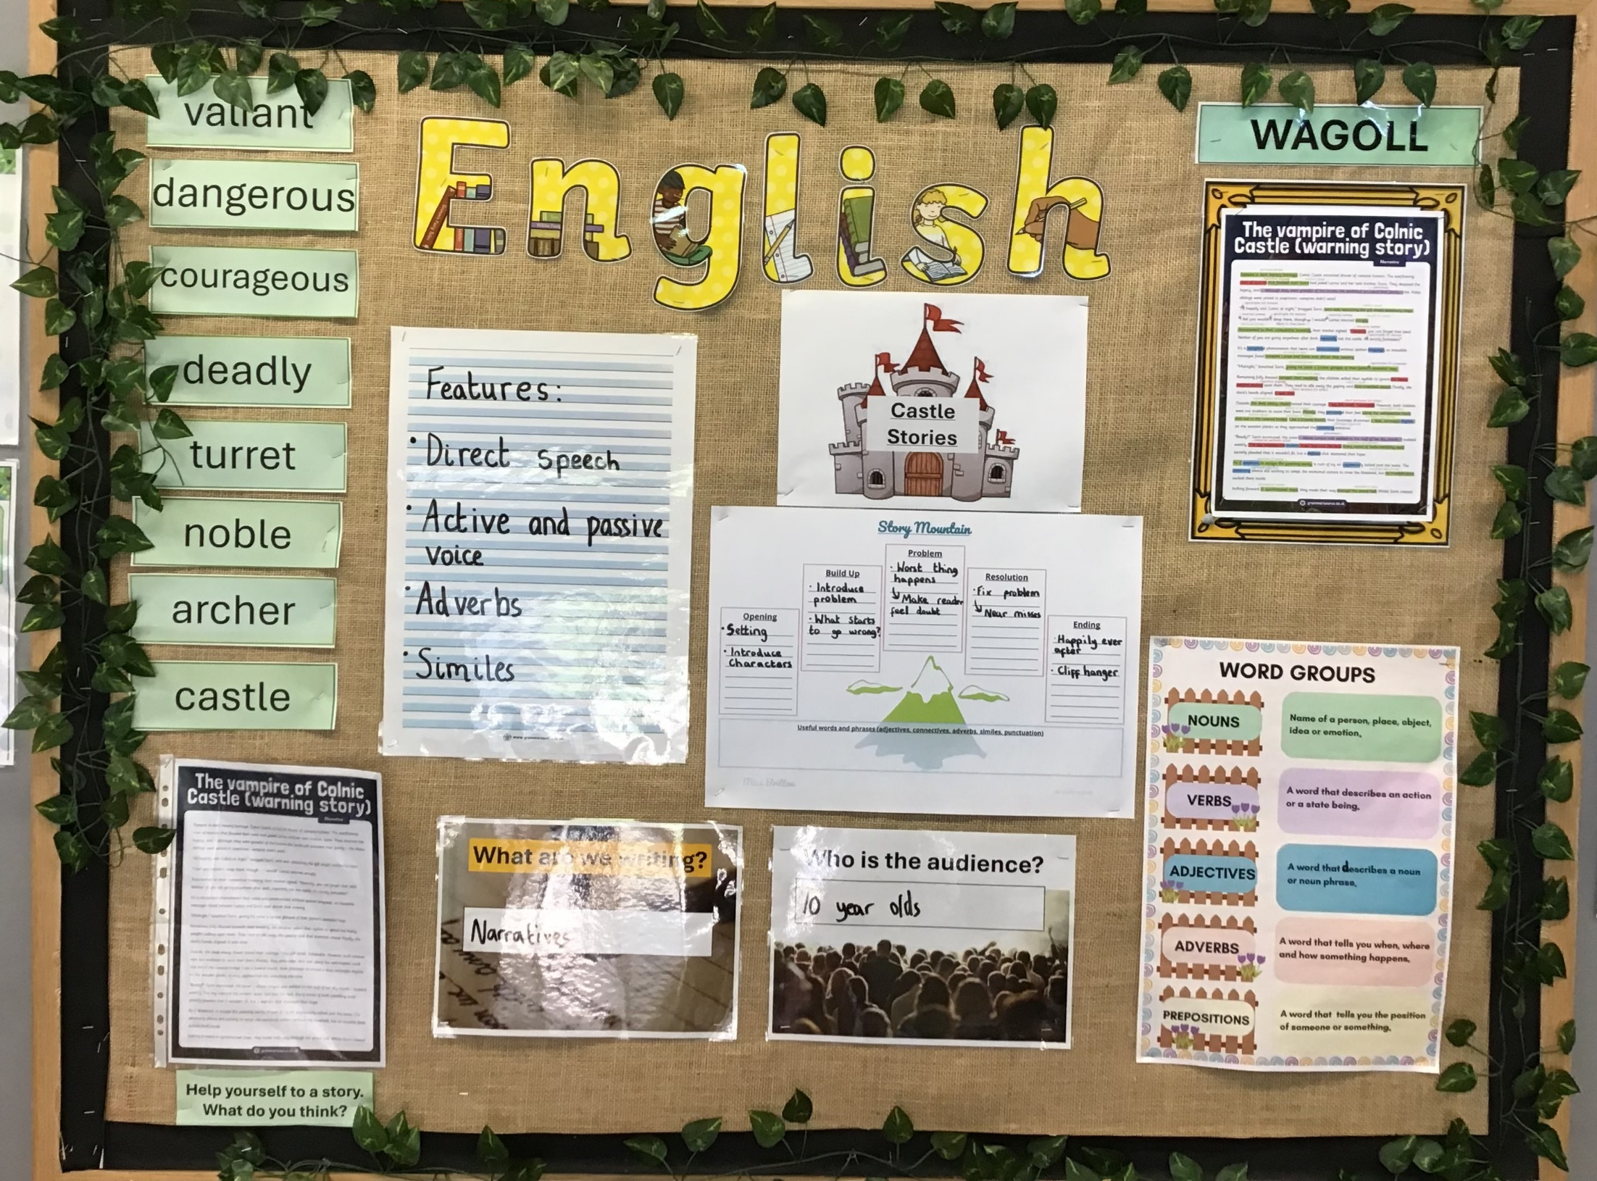
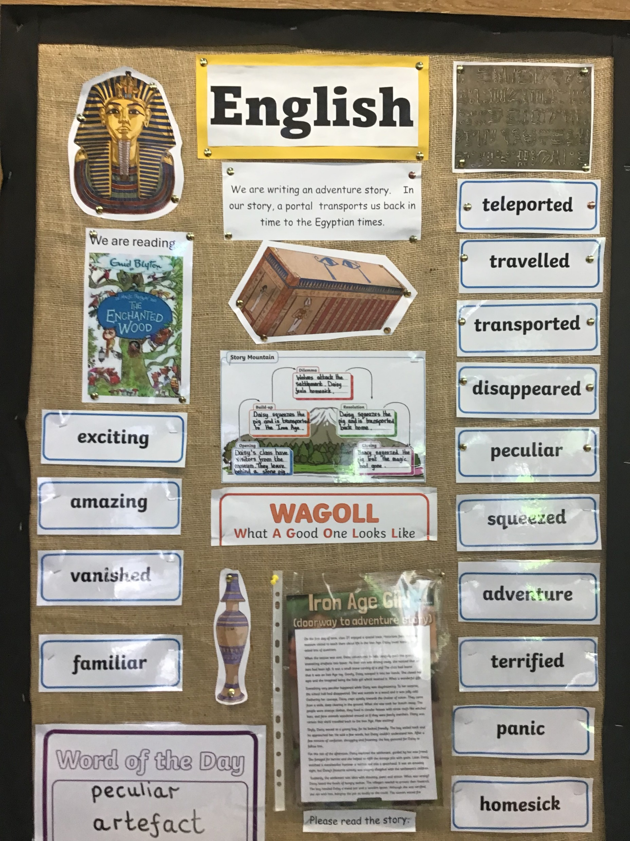
Learning Environment (including Displays)
Celebrate Children’s work:
Ensure work is current, relevant and labelled.
Show a learning journey
Working Walls:
Current topic
Accessible to all learners
Include a WAGOLL
Less is more!
Labels and Resources:
Accessible scaffolds and learning aids
Resources clearly labelled (using widget symbols too.)
Include Key Vocabulary:
Consider the needs of the class (support and extend)
Helps to develop and enrich writing, spelling and speech.
Interactive Displays:
Make displays interactive to encourage pupil participation
Extend learning through challenge

